Slide 1
Operating System Security
Liu Cui

Slide 2
Road Map
Process Security
Memory and Filesystem Security
Application Software Security

Slide 3
Process Security
To protect a computer while it is running, it is essential to monitor and protect the processes that are running on that computer.
Inductive Trust from Start to Finish
The trust that we place on the processes running on a computer is an inductive belief based on the integrity of the processes that are loaded when the computer is turned on, and this state is maintained even if the computer is shut down or put into a hibernation state.

Slide 4
Process Security—The boot Sequence
The action of loading an operating system into memory from a powered-off state is known as booting.
Initially, all of the operating system’s code is stored in persistent storage, typically the hard drive.
In order for the operating system to execute, it must be loaded into memory.
When a computer is turned on, it first executes code stored in a firmware component known as Basic Input/Output System(BIOS).
The BIOS loads into memory the second-stage boot loader, which handles loading the rest of the operating system into memory and then passes control of execution to the operating system.

Slide 5
Process Security – Attacks
A malicious user could potentially seize execution of a computer at several points in the boot process.
To prevent an attacker from initiating the first stages of booting, many computers feature a BIOS password that does not allow a second-stage boot loader to be executed without proper authentication.

Slide 6
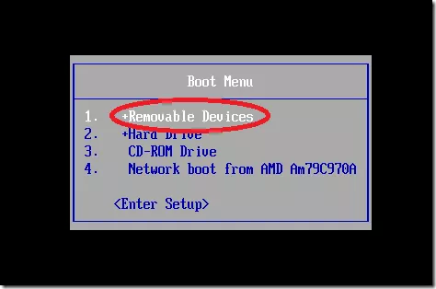
Boot Device Hierarchy
Notes:
Most second-stage boot loaders allow the user to specify which device should be used to load the rest of the operating system. In most cases, this option defaults to booting from the hard drive, or in the event of a new installation, from external media such as a DVD drive. Thus, one should make sure that the operating system is always booted from trusted media.

Slide 7
Hibernation
While going into hibernation, the operating system stores the entire contents of the machine's memory into a hibernation file on disk (C:\hiberfil.sys).
Purpose: computer can be quickly resorted when the system is powered back on.
However, with the entire contents of memory (passwords, sensitive information), hibernation exposes a machine to potentially invasive forensic investigation.
Attacks: (1) get the sensitive data, (2) destroy the hibernation file

Slide 8
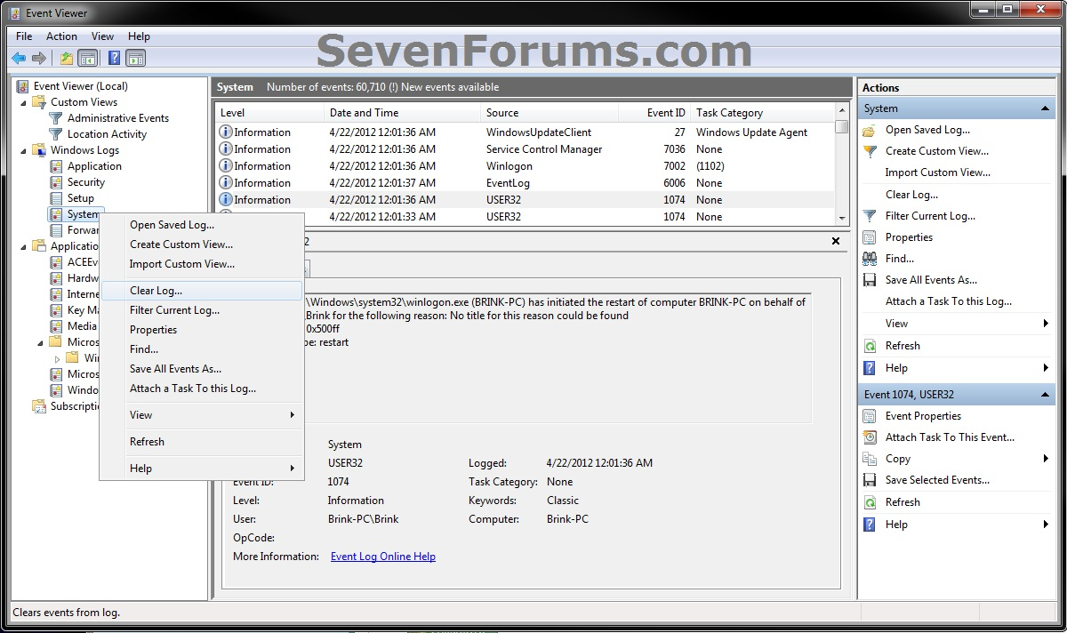
Monitoring, Management, and Logging
Event Logging
Notes:
Windows defines three possible sources of logs, “System”, “Application,” and “Security”. The system log can only be written to by the operating system itself, while the application log may be written to by ordinary applications. Finally, the security log can only be written to by a special windows service known as the Local Security Authority Subsystem Service, visible in Process Explorer as lsass.exe. This service is responsible for enforcing security policies such as access control and user authentication. In addition to these three predefined sources, users can define their own log sources. Each log entry is known as an event. Events are given unique identifiers, which correspond to any of the potential occurrences on a Windows machine that might prompt logging.

Slide 9
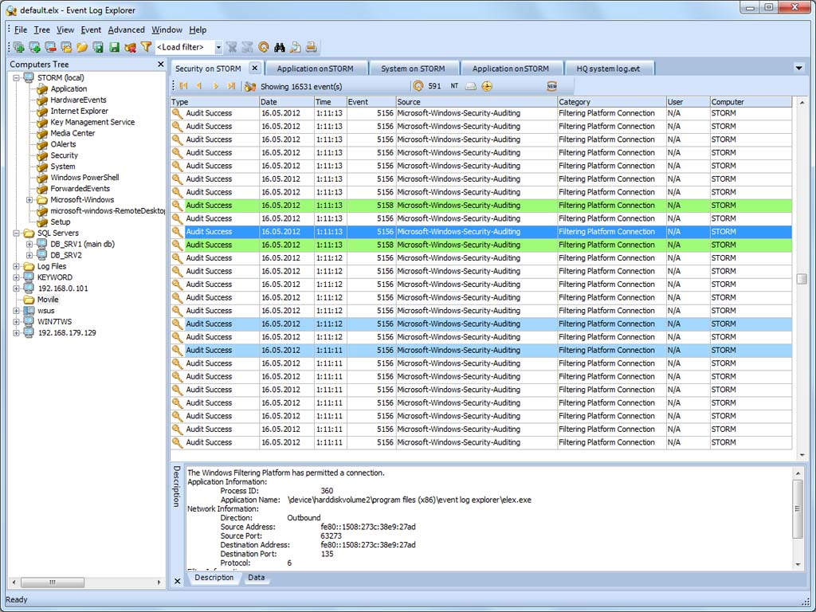
Process Monitoring
Scenarios where we would like to find out exactly which processes are currently running on:
Computer might be sluggish and we want to identify an application using up lots of CPU cycles or memory
Suspect that our computer has been compromised and we want to check suspicious processes
Process Explorer

Slide 10
Memory and Filesystem Security
Virtual memory: is a useful tool for operating systems. It allows for multiple processes with a total address space larger than our RAM memory to run effectively, and it supports these multiple processes to each view its address spaces as being contiguous.
Windows: virtual memory pages that have been written to the hard disk are actually contained in what is known as the page file, located at c:\pagefhile.sys
Linux: requires users to set up an entire partition of their hard disk, known as the swap partition, to contain memory pages.

Slide 11
Attacks on Virtual Memory
Goal: get virtual memory pages to see sensitive information
How: suddenly powered off the machine without properly shutting down and booted to another operating system via external media.
Mitigation: hard disk encryption should be used in all cases

Slide 12
Password-Based Authentication
The question of who is allowed access to the resources in a computer system begins with a central question of operating systems security:
How does the operating system securely identify its users?

Slide 13
Password-Based Authentication
A standard authentication mechanisms used by most operating systems is for users to log in by entering a username and password.
If the entered password matches the stored password associated with the entered username, then the system accepts this authentication and logs the users into the system.
That means you need to store password on the hard drive.
How to make it secure?

Slide 14
Password-Based Authentication
How to make it secure?
Hash function
Why it is secure?
One way
How to break?
Dictionary attack
How to mitigate?
Salt: add randomness to the password
(U,S,h(S||P))

Slide 15
How Salt increases search space size
Without salt, D is the size of the list of words, usually 500,000
With salt, length = 2^{B}*D, B is the number of bits of the random salt
With 32 bits, it increases the total length to 2,147,483,648,000,000

Slide 16
Access Control and Advanced File Permissions
Once a user is authenticated to a system, the next question that must be addressed is that of access control:
How does the operating system determine what users have permission to do?

Slide 17
Access Control and Advanced File Permissions
Principal is either a user or a group of users
Permission is a specific action on a file or folder
Read
Write
A folder may also have a list permission, which refers to being able to inspect(list) the contents of the folder
Execute permission, allows for setting the current directory as that folder.

Slide 18
User account management
Password Policy
Enforce password history policy: set how often an old password can be reused.
Minimum password age policy: how long users must keep a password before they can change it
Maximum password age policy: how long users can keep a password before they are required to change it
Minimum password length policy: at least eight characters for the current computation capabilities
Password must meet complexity requirements policy
Reset password: every 180 days
Use strong passphrases: a minimum of 15 characters should always be used to protect domain administrator account
Password audit policy: allow you to track all password changes
Email notification prior to password expiry to remind your users when it’s time to change their passwords

Slide 19
User account management
Authentications Methods
Biometrics
Token
Transaction (location based)
Multi-factor
Out-of-Band

Slide 20
User account management
Group Policies
Different groups of people may have different capabilities:
Faculty: read, write
Student: read
Administrator: read, write, delete

Slide 21
Access Control and Advanced File Permissions
Implementation issues:
How do permissions interact with the file organization of the system?
Is there a hierarchy of inheritance?
If a file resides in a folder, does it inherit the permissions of its parent, or override them with its own permissions?
What happens if a user has permission to write to a file but not to the directory that the file resides in?
If permissions aren’t specifically granted or denied, are they implied by default?

Slide 22
File Descriptors
File descriptor table
File descriptor leaks
When a process creates a child process, that child process inherits copies of all of the file descriptors that are open in the parent.
The operating system only checks whether a process has permissions to read or write to a file at the moment of creating a file descriptor entry
What may happen:
A program with high privileges opens a file descriptor to a protected file, fails to close it, and then creates a process with lower permissions.
Since the new process inherits the file descriptors of its parent, it will be able to read or write to the file, depending on how the parent process issued the open system call, regardless of the fact that the child process might not have permission to open that file in other circumstances.
Notes:
In order for processes to work with files, they need a shorthand way to refer to those files, other than always going to the filesystem and specifying a path to the files in question In order to efficiently read and write files stored on disk, modern operating systems rely on a mechanisms known as file descriptors. File descriptors are essentially index values stored in a table, aptly known as the file descriptor table. When a program needs to access a file, a call is made to the open system call, which results in the kernel creating a new entry in the file descriptor table which maps to the file’s location on the disk. This new file descriptor is returned to the program, which can now issue read or write commands using that file descriptor. When receiving a read or write system call, the kernel looks up the file descriptor in the table and performs the read or write at the appropriate location on disk. Finally, when finished, the program should issue the close system call to remove the open file descriptor.

Slide 23
Application Program Security
Many attacks don’t directly exploit weaknesses in the OS kernel, but rather attack insecure programs.
Buffer Overflow
In any situation where a program allocates a fixed-size buffer in memory in which to store information, care must be taken to ensure that copying user-supplied data to this buffer is done securely and with boundary checks. If this is not the case, then it may be possible for an attacker to provide input that exceeds the length of the buffer, which the program will then dutifully attempt to copy to the allotted buffer. However, because the provided input is larger than the buffer, this copying may overwrite data beyond the location of the buffer in memory, and potentially allow the attacker to gain control of the entire process and execute arbitrary code on the machine.

